Slide 1
Project 06: Airbnb and Real Estate Market
Presented by
Nadia Siddiqui
Fahmida Pervin
EECS 6414
Data Analytics and Visualization
Winter 2019

Slide 2
Agenda
Introduction
Data Cleansing
Methodology
Evaluation
Results(Highlights)
References
Conclusion

Slide 3
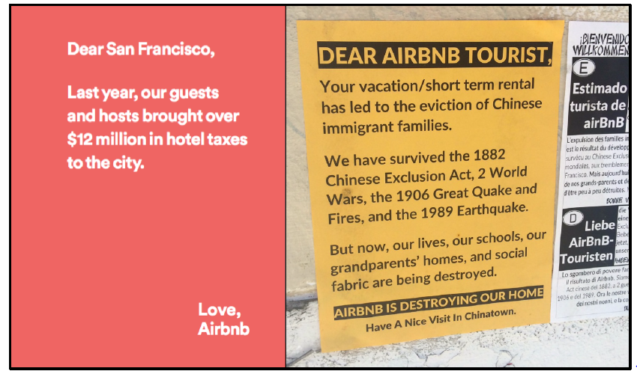
Introduction
Airbnb revenue flow
-systematic but geographically uneven
-Creating rent gap in recognizable neighborhoods subject to extensive long-term rental
-Being motivated by a San Francisco poster, we performed analysis on 3 years of Airbnb activity in Toronto to measure
1. the amount of rental housing lost to Airbnb,
2. Revenue flows into the short-term rental market,
3. identify neighborhoods significantly impacted by short-term rentals at the cost of long-term rental housing

Slide 4
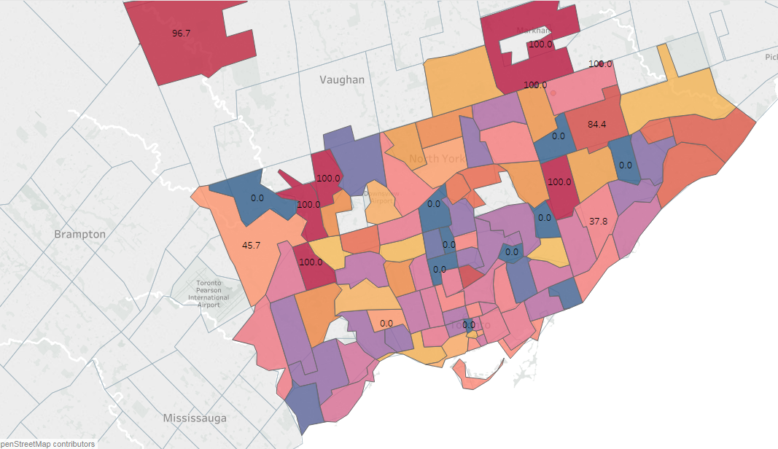
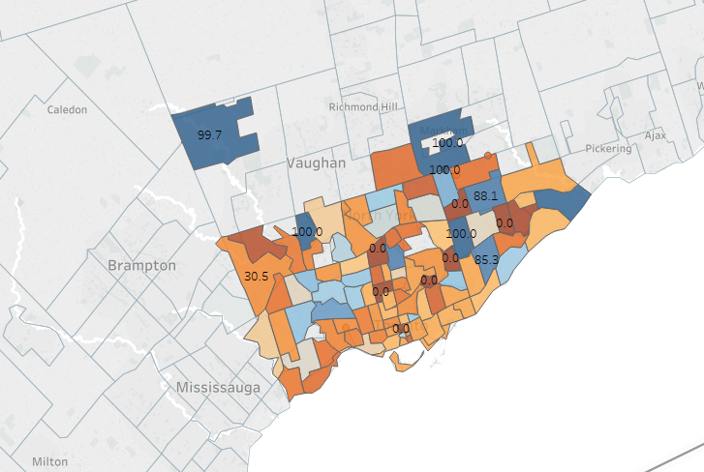


The percentage of rental housing units in 2019 occupied on Airbnb more than 30 days and available 365 days a year, and hence likely to have been removed from the long-term rental market. Toronto’s housing supply is seeing 19,255 housing units shifted from seeing long-term rental market to short term market.

Slide 5
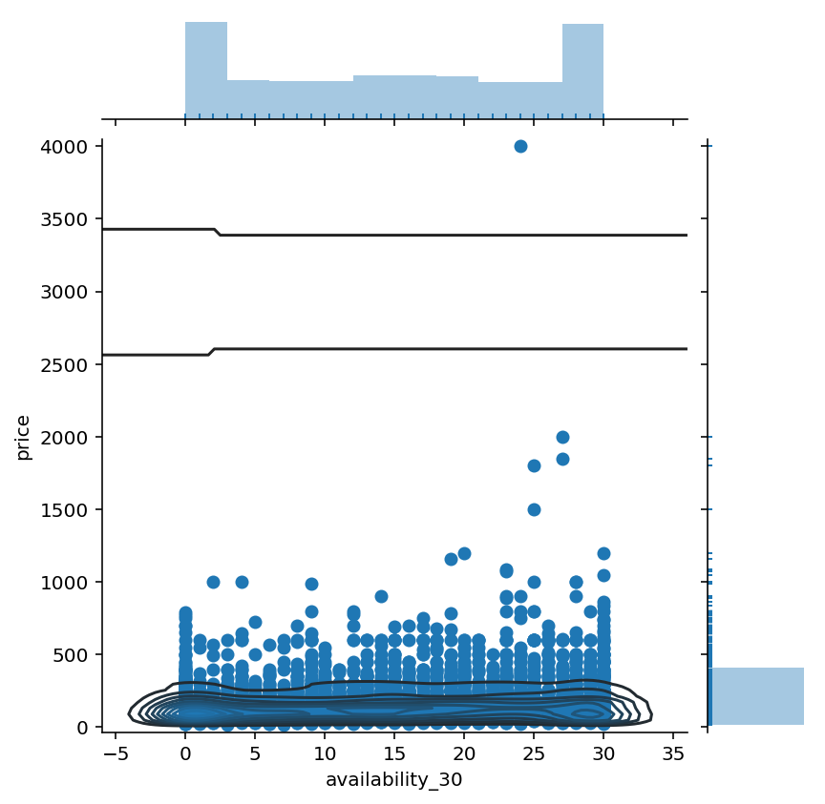
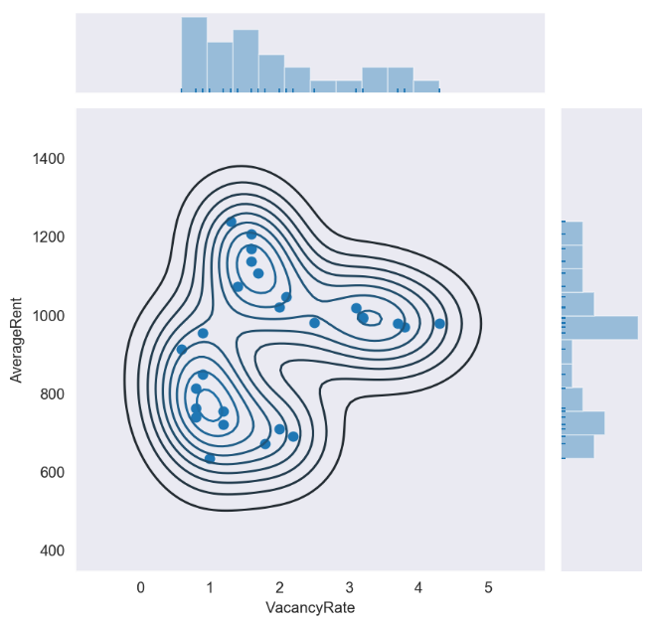
Airbnb & Real Estate Rent gaps:
In 2015 Airbnb revenue was 50 Million USD in Toronto and 200 Million in December 2018.
 | One Bed Room |  |  | Two Bed Room
 | Rental | Airbnb | Rent Gap (%) | Rental | Airbnb | Rent Gap (%)
King West | 1264 | 1960 | 55% | 1510 | 3325 | 120%
Church-Yonge Corridor | 1798 | 1978 | 10% | 2355 | 3770 | 60%
Waterfront Communities | 2278 | 2962 | 30% | 3395 | 4615 | 35%
Greater Toronto Area | 1442 | 1735 | 20% | 1685 | 3035 | 80%
Rental Average Rent (King West) and Airbnb Revenue by Availability

Slide 6
Data Cleansing(Using Python & OpenRefine)
Airbnb (1 Gb Data)
Rental Market (200 Mb)
Listings.Csv, Neighborhood.Csv, Calendar.Csv And Review.Csv For Toronto (2015-2019 )
Date Format Conversion
Change Datatype Of Rent From String To Float
Categorical Feature: ‘Availability’ Was Shaped Into Boolean Value (T/F)
Missing Values Were Imputed
Outliers Were Removed
Review Score Range, Amenities, Response Time And Other 7 Categorical Values Were Encoded
HousingIndex.Csv, TimeZone.Csv and Neighborhood.Csv for Toronto (1990-2019)
Date Format Conversion
Change Datatype Of Rent From String To Float
Neighborhood latitude and longitude insertion
Missing Values Imputation
Outliers Removal

Slide 7
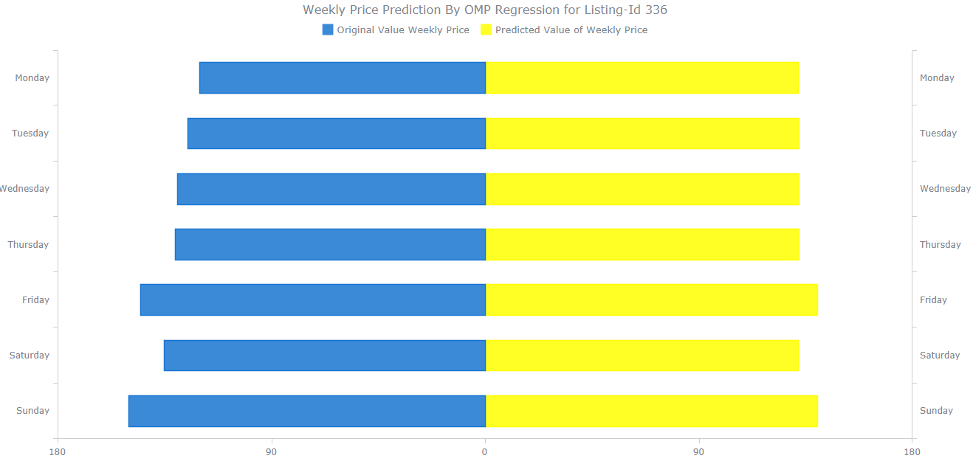
Airbnb Seasonality Analysis (Weekends and Weekdays)
Weekdays price variation of Airbnb by listing ID

Slide 8
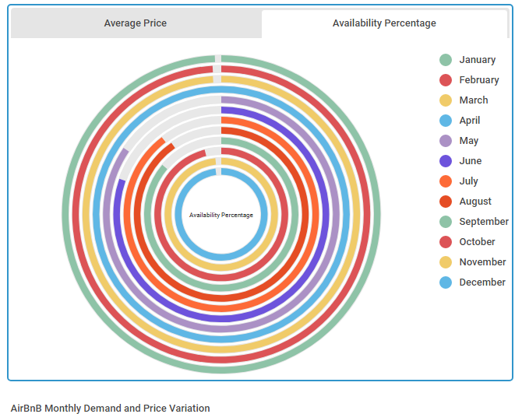
Airbnb Demand Analysis through 2015 to 2019
D3 radial column graph. It shows the percentage of listings that become unavailable in Toronto per month, through 2015 to 2019 with spikes from May to September at Summer times.

Slide 9
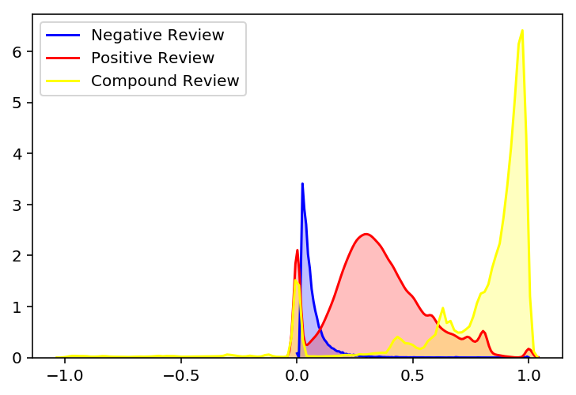
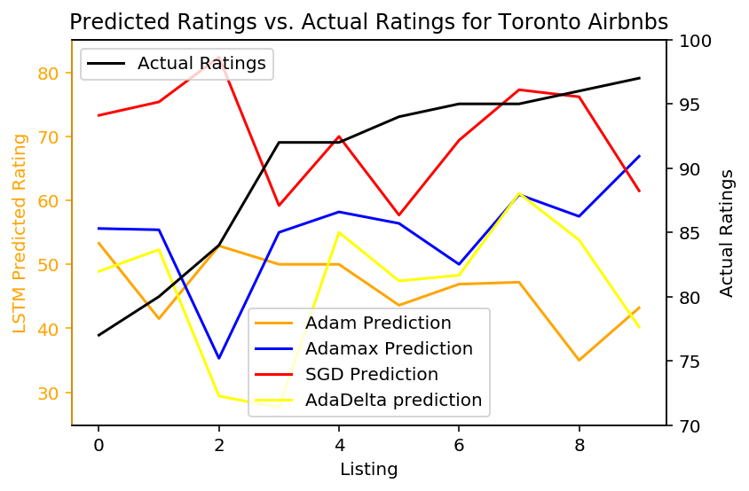
Rating and Review effects on Airbnb Market Only
Sentiments of Reviewers
Predicted versus Actual Rating

Slide 10
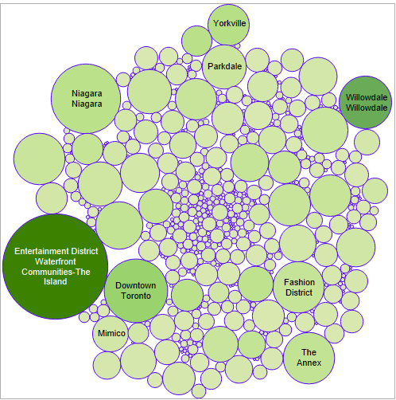
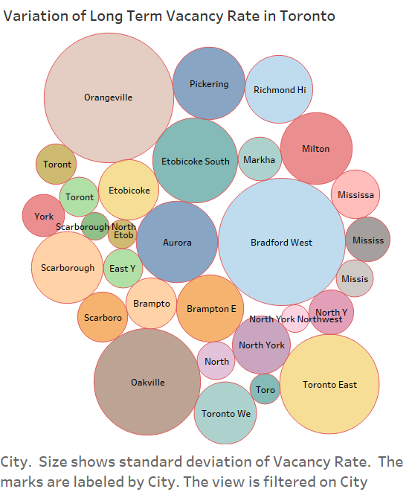
Neighborhood effect on Both Segment
Area Wise Demand Variation Of Long-term Rental
Area Wise Demand Variation Of Airbnb

Slide 11
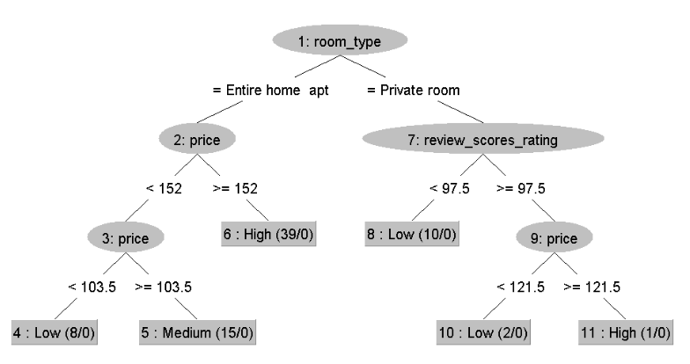
Decision Tree: Toronto Airbnb
Our research hypotheses question is how prices of Airbnb and Long-term Market are determined
Important Factors are Price & Review Score Rating

Slide 12
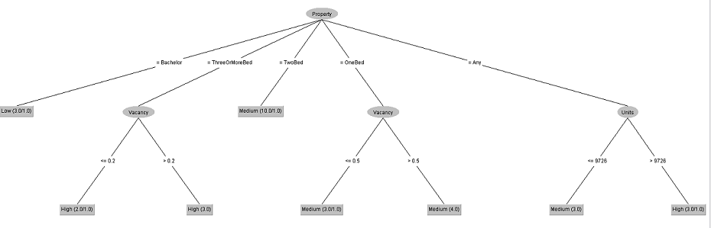
Decision Tree: Rental Market
Pruned C4.5 Decision tree, using confidence factor 0.25
vacancy rate, room type, number of units in the market.

Slide 13
Toronto Housing Stock
This study was focused study to analysis how short term and seasonal cities are affecting Canadian real estate market.
How big portion of residential units is been used by Airbnb Toronto?
 | 2016
Total Housing Units | 1,179,057
Airbnb | 19,255 | 1.6 %

Slide 14
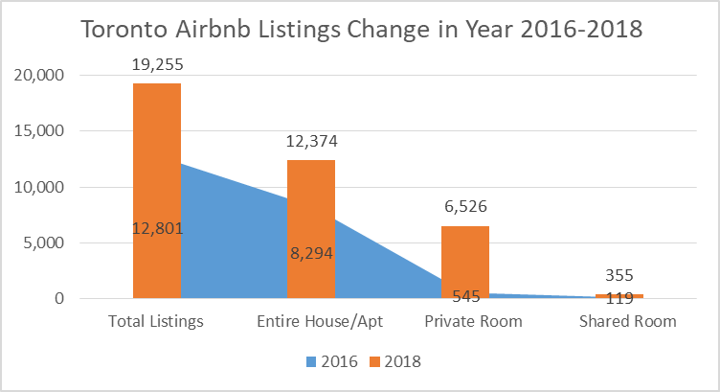
Toronto Housing Stock Comparison in 2016 -2018
 | 2016 | 2018 | Increase
Airbnb Listings | 12,801 | 19,255 | 150%
Entire House/Apt | 8,294 | 12,374 | 49%
Private Room | 545 | 6,526 | 1097%
Shared Room | 119 | 355 | 198%

Slide 15
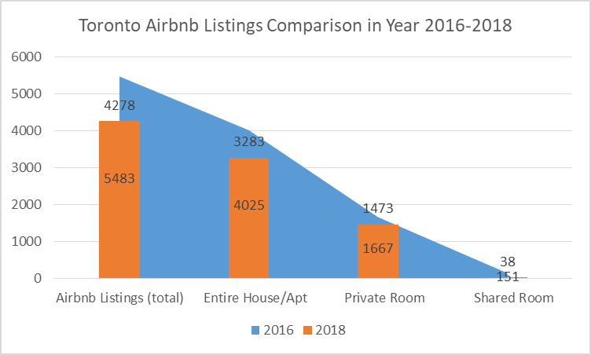
Vancouver Airbnb Listings Comparison 2016-2018
 | 2016 | 2018 | Decrease
Airbnb Listings | 5483 | 4278 | -22%
Entire House/Apt | 4025 | 3283 | -18 %
Private Room | 1667 | 1473 | -12 %
Shared Room | 151 | 38 | -75 %

Slide 16
“Unfilled”Rent Gap
To measure the “unfilled” rent gap, we compared Airbnb host revenues with what those hosts likely could have earned on the traditional rental market.
The intuition here is that, in the absence of strong policies to prevent property owners from converting long-term rentals to short-term rentals, a rough revenue equilibrium should emerge between the two. If you are a landlord earning $1800/month in rent for an apartment
For example 5 Bed , 5 bath house , per month 20150 on Airbnb

Slide 17
Highlights of Results on Two Segments

